Slide 1
MODULE 20: EVACUATION PROCEDURES
TCCC TIER 1
All Service Members
TCCC TIER 2
Combat Lifesaver
TCCC TIER 3
Combat Medic/Corpsman
TCCC TIER 4
Combat Paramedic/Provider

Slide 2
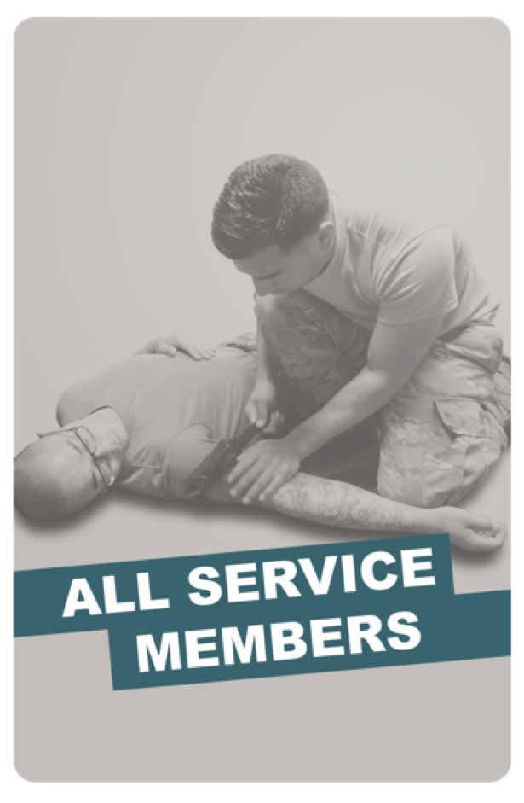
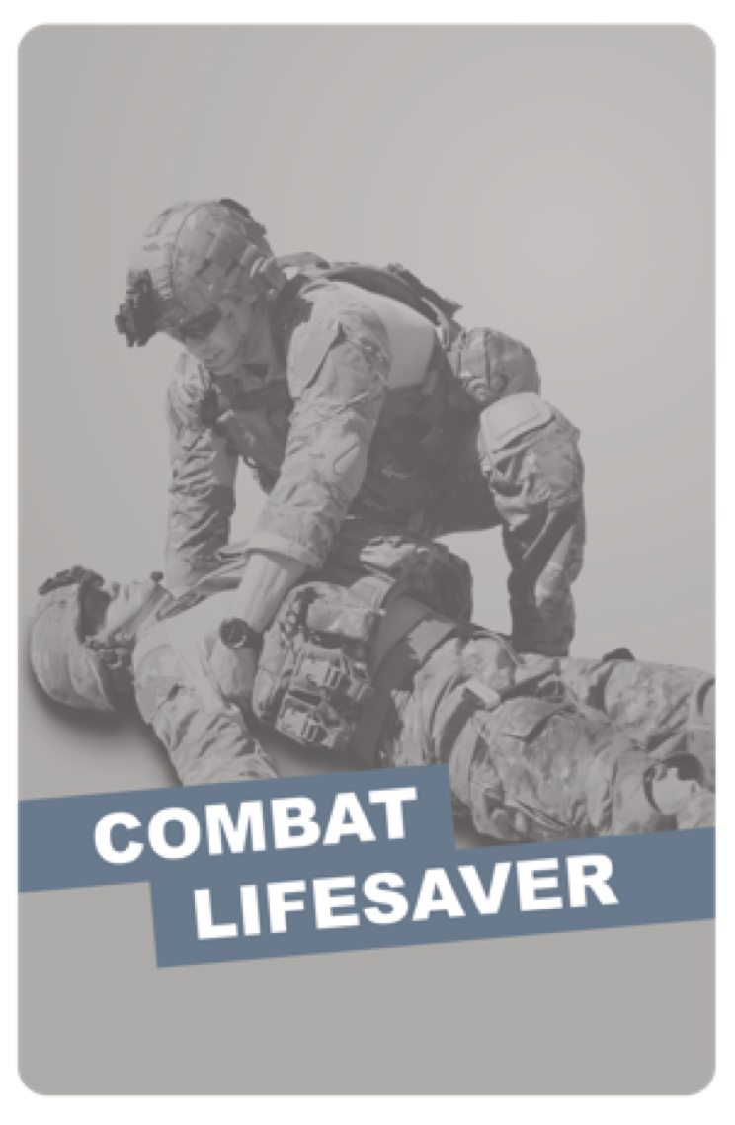
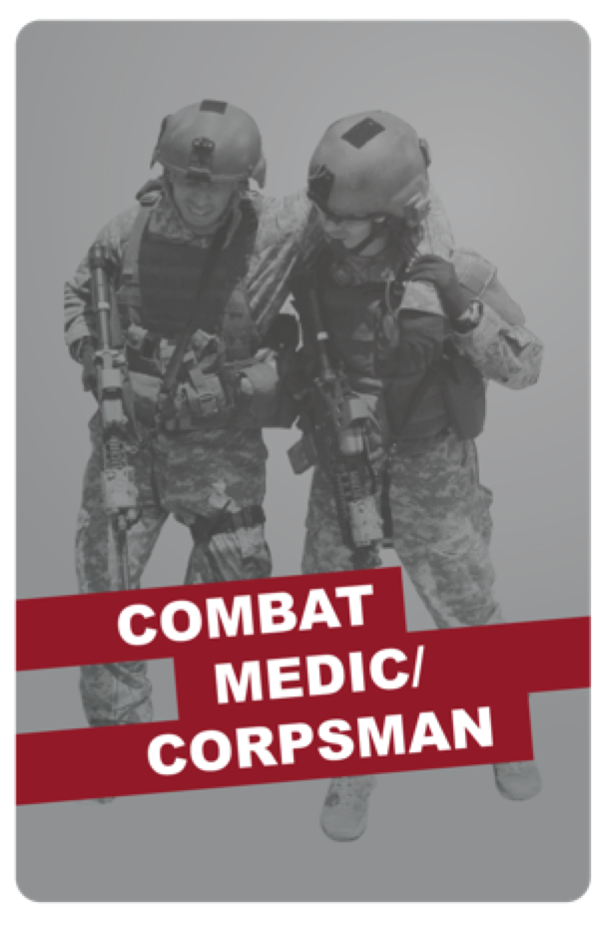
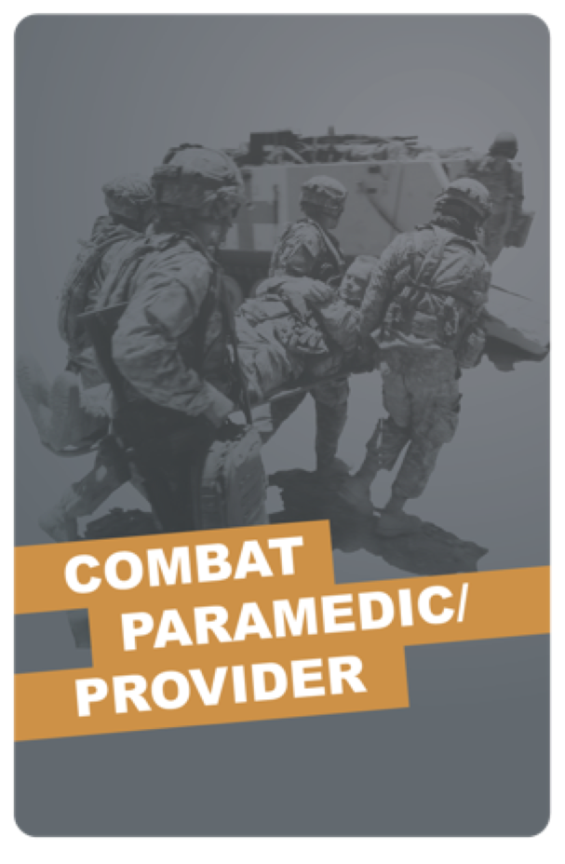
TACTICAL COMBAT CASUALTY CARE (TCCC) ROLE-BASED TRAINING SPECTRUM
ROLE 1 CARE
NONMEDICAL PERSONNEL
MEDICAL PERSONNEL
ASM
CMC
CPP
CLS
YOU ARE HERE
STANDARDIZED JOINT CURRICULUM

Slide 3
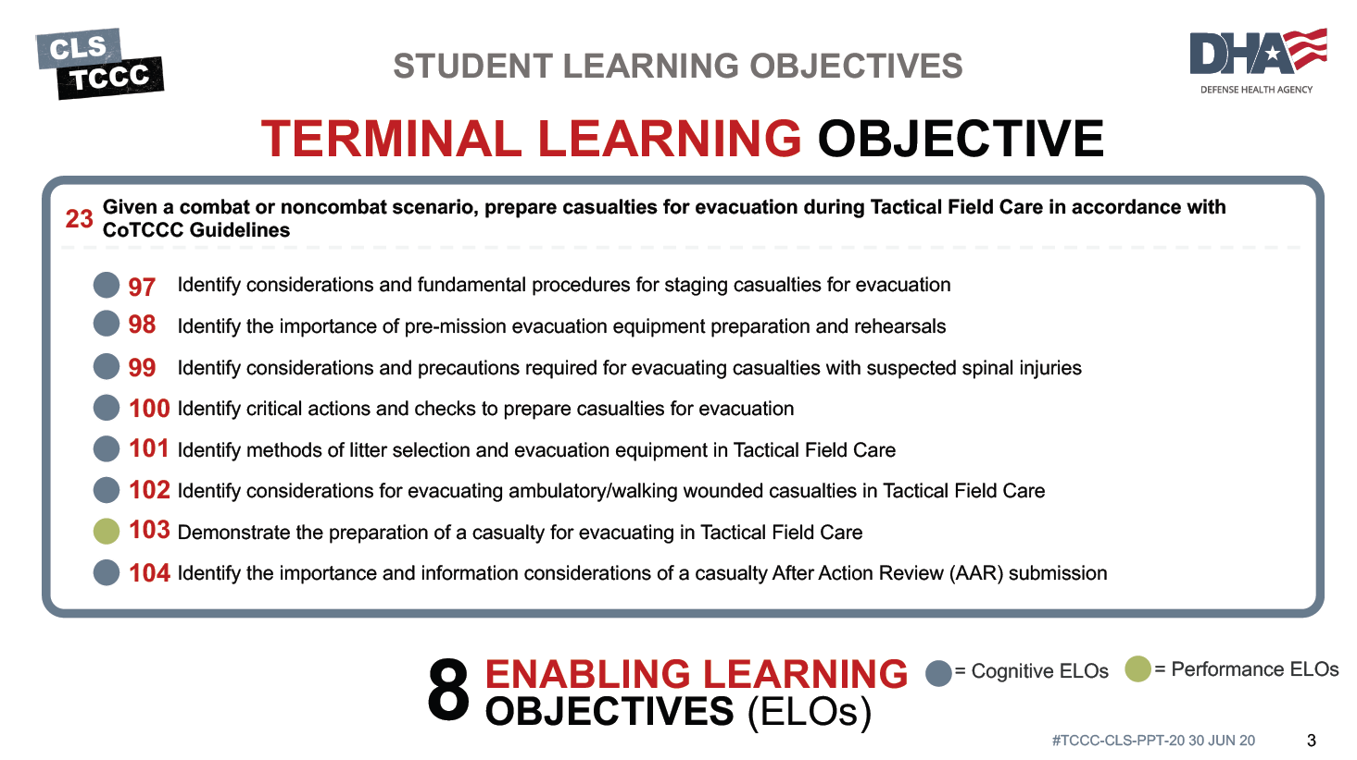


TERMINAL LEARNING OBJECTIVE
STUDENT LEARNING OBJECTIVES
8
ENABLING LEARNING OBJECTIVES (ELOs)
= Cognitive ELOs
= Performance ELOs

Slide 4


Three PHASES of TCCC
TACTICAL EVACUATION CARE
1 CARE UNDER FIRE
RETURN FIRE AND TAKE COVER
Quick decision-making:
▪ Consider scene safety
▪ Identify and control life- threatening bleeding
▪ Move casualty to safety
₂ TACTICAL FIELD CARE
COVER AND CONCEALMENT
Basic Management Plan:
▪ Maintain tactical situational awareness
▪ Triage casualties as required
▪ MARCH-PAWS assessment
TACTICAL EVACUATION CARE
More deliberate assessment and treatment of unrecognized
life-threatening injuries
Pre-evacuation procedures
Continuation of documentation
3
YOU ARE HERE
NOTE: This is covered in more advanced TCCC training!

Slide 5

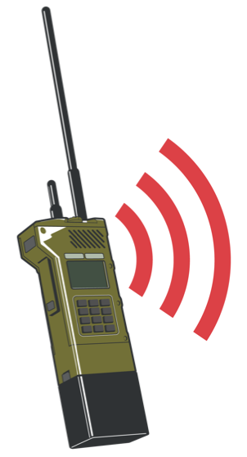
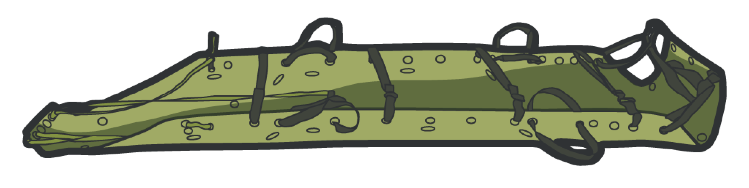
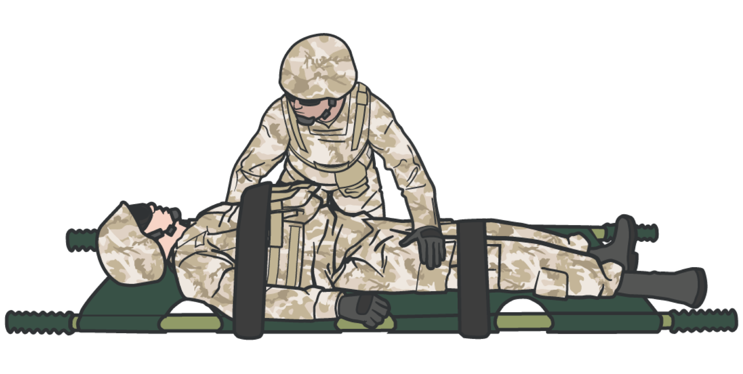
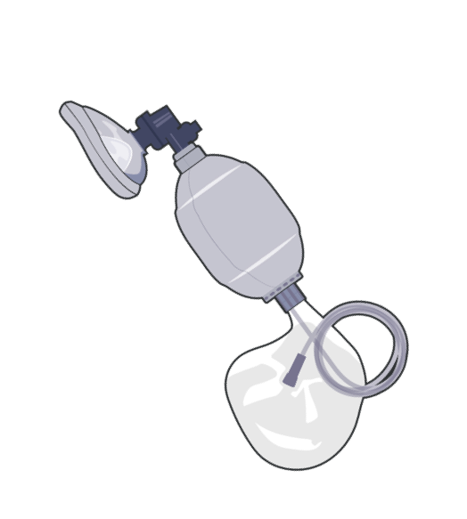
EVACUATION PROCEDURES
IMPORTANT ACTIONS
(IN THIS MODULE)
SECURE ITEMS
CHOOSE AND PREP LITTER
PREP EVAC EQUIPMENT
PACKAGE CASUALTY FOR EVACUATION

Slide 6




EVACUATION PROCEDURES
SECURE CASUALTY’S EQUIPMENT
Secure the casualty’s weapon and equipment in accordance with unit SOP or mission requirements
Clear and render safe any weapons evacuated with the casualty
Do not evacuate explosives with the casualty if possible
Keep in mind that receiving medical personnel may not be familiar with the equipment or have a way to secure it

Slide 7
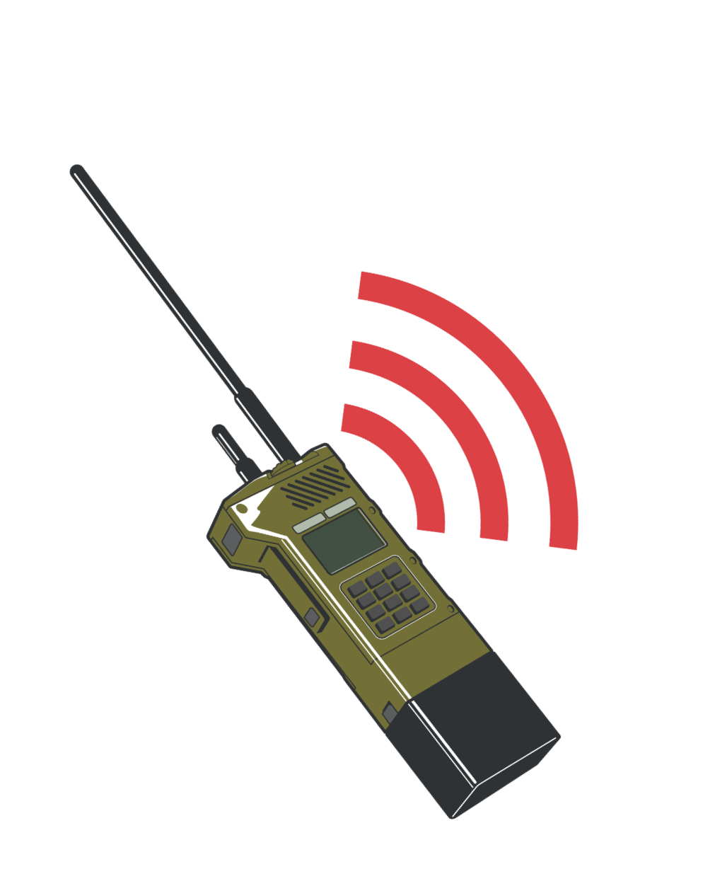
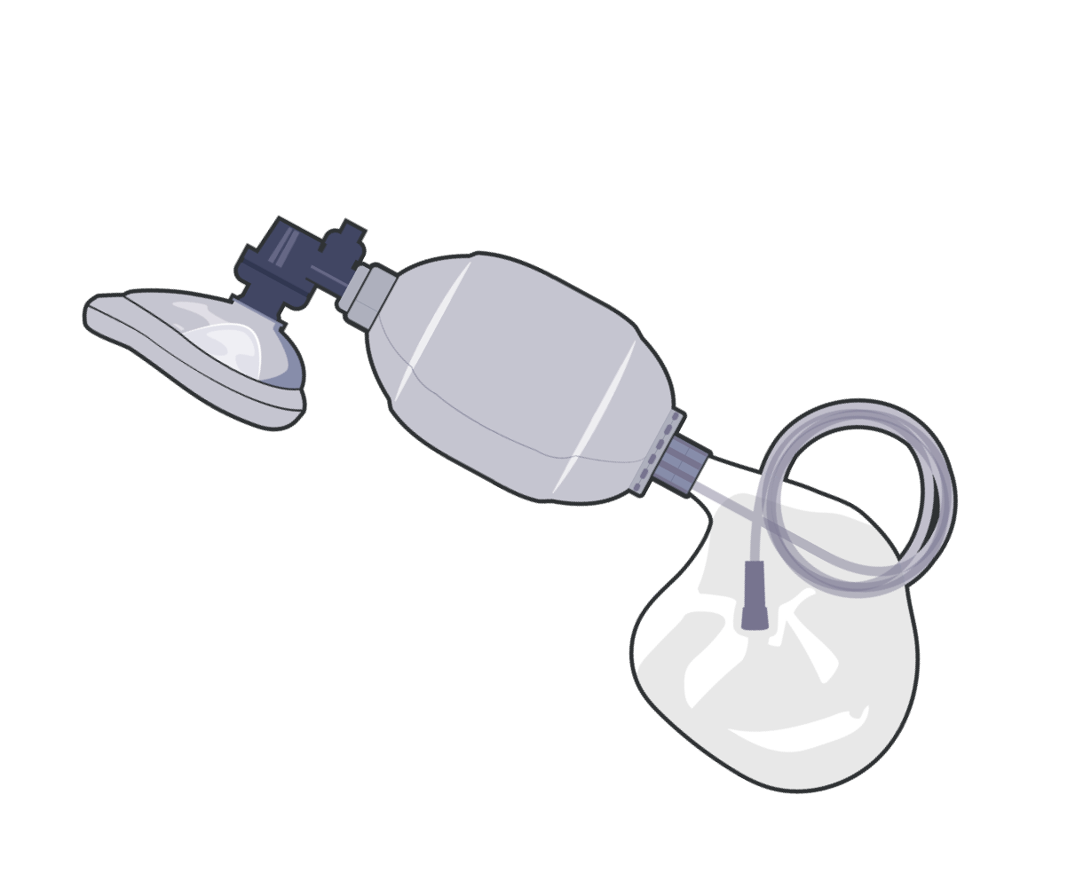
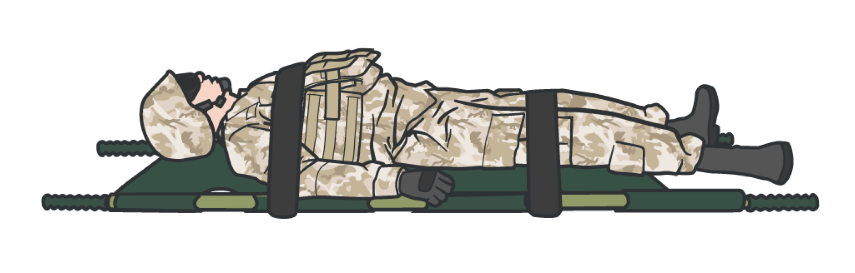
EVACUATION PROCEDURES
EVAC EQUIPMENT
Prepped by unit personnel while treatment continues
Coordinate other EVAC activities
Do not delay getting casualties onto litters
Hypothermia is better prevented off the ground
Easier to move casualty on litter
Keep necessary medical equipment with the casualty (Ex: BVM)

Slide 8
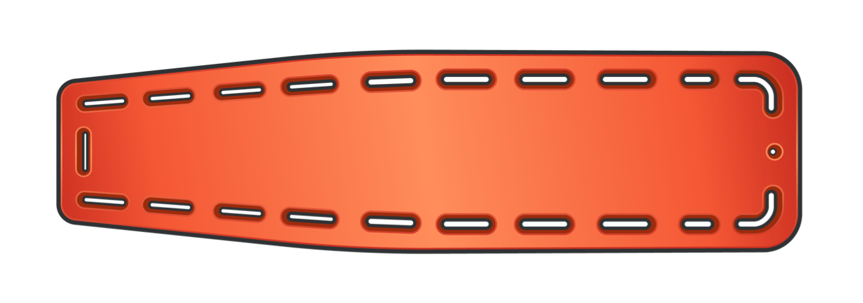


EVACUATION PROCEDURES
LITTERS
Casualty movement is easier using litters Use best position for care and comfort
You DO NOT have to place casualty on back
For casualties with spinal injuries, keep spinal column as straight as possible
CASUALTY MUST BE SECURED
before movement
Select litter based on mission or unit
Consider and train according to operating environment:
Equipment Movement
Rehearse litter open/setup/carry

Slide 9
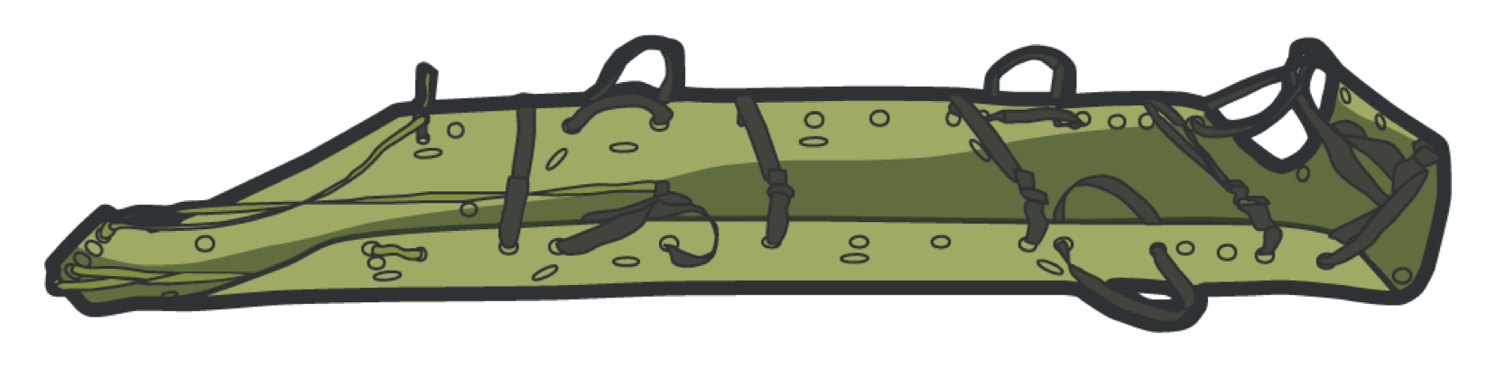
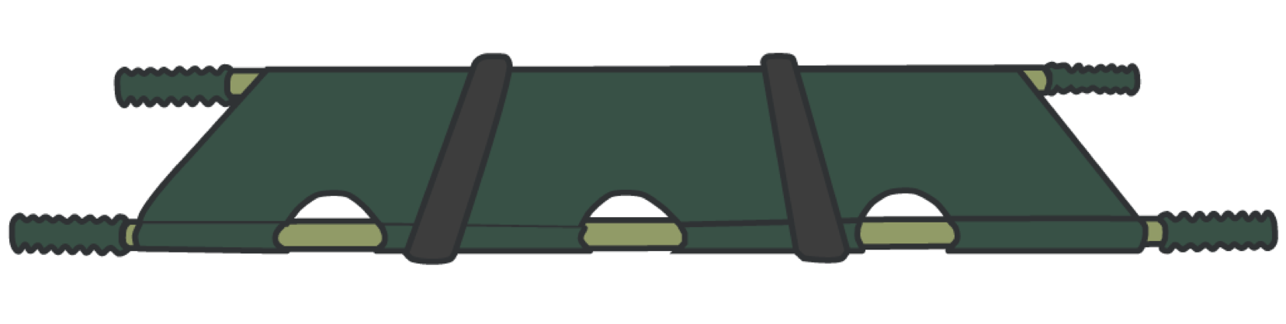









EVACUATION PROCEDURES
LITTER SELECTION
Compact/lightweight transport system
Compact quad-folding litter
Lightweight
Rough terrain (if dragging)
Small
Requires more than one warfighter
May not fit in evacuation vehicle
Two-warfighter carry
Carrying case
Draggable by one warfighter
Carried like a rucksack

Slide 10
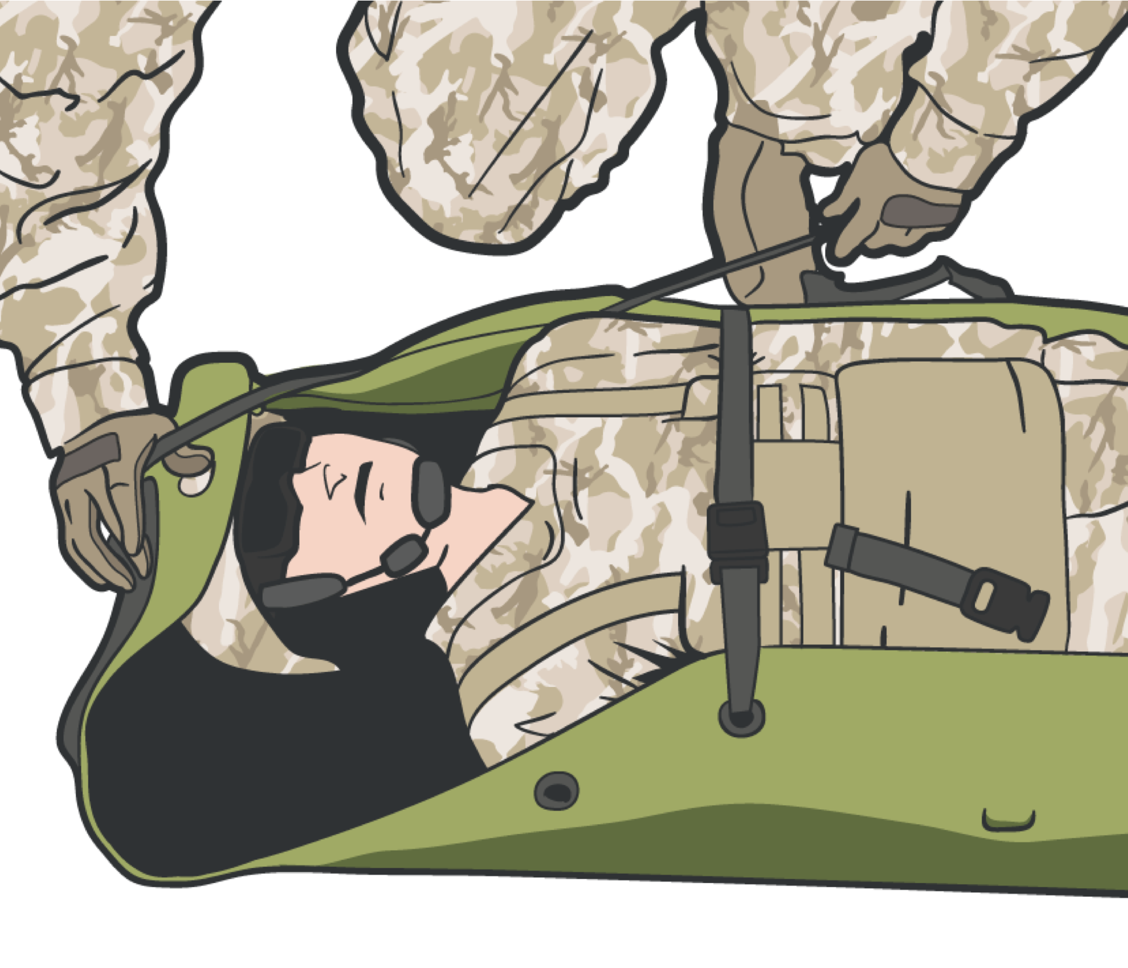
EVACUATION PROCEDURES
PACKAGE THE CASUALTY
Secure loose ends of bandages, medical equipment, and hypothermia prevention materials
During evacuation, loose materials may get caught and cause further injury to casualties or delays
Prevent items from being blown by rotor wash or becoming entangled with other equipment
Blankets and hypothermia materials are especially susceptible to becoming entangled
Secure the casualty to a litter
Properly secure completed DD Form 1380

Slide 11

EVACUATION PROCEDURES
EVACUATION CONSIDERATIONS FOR SUSPECTED SPINAL INJURIES
Events to consider for neck or back injuries: falls, motor vehicle accidents, IEDs, fast-roping injuries, etc.
Ensure cervical (neck) spine (C-spine) immobilization when spinal cord injury is suspected, if possible
Note: Spine board is requested during 9-Line (special equipment)
When considering selection of litter (such as standard litters) based on mission and unit, realize that the selected litter may not fit in the given evacuation ground/air vehicle
Ex: M1114 or M1151 Up-armored High Mobility Multipurpose Wheeled Vehicle (HMMWV-Humvee)

Slide 12
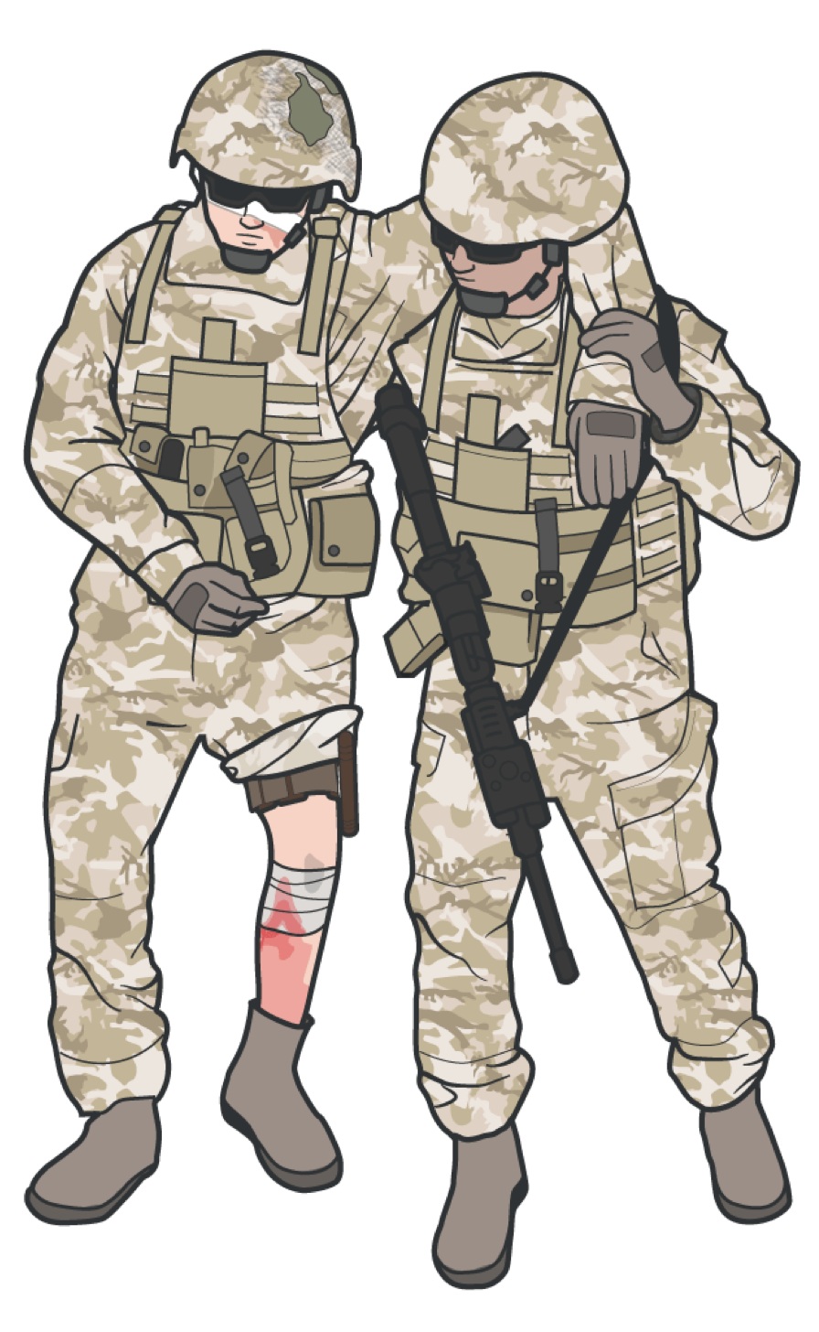
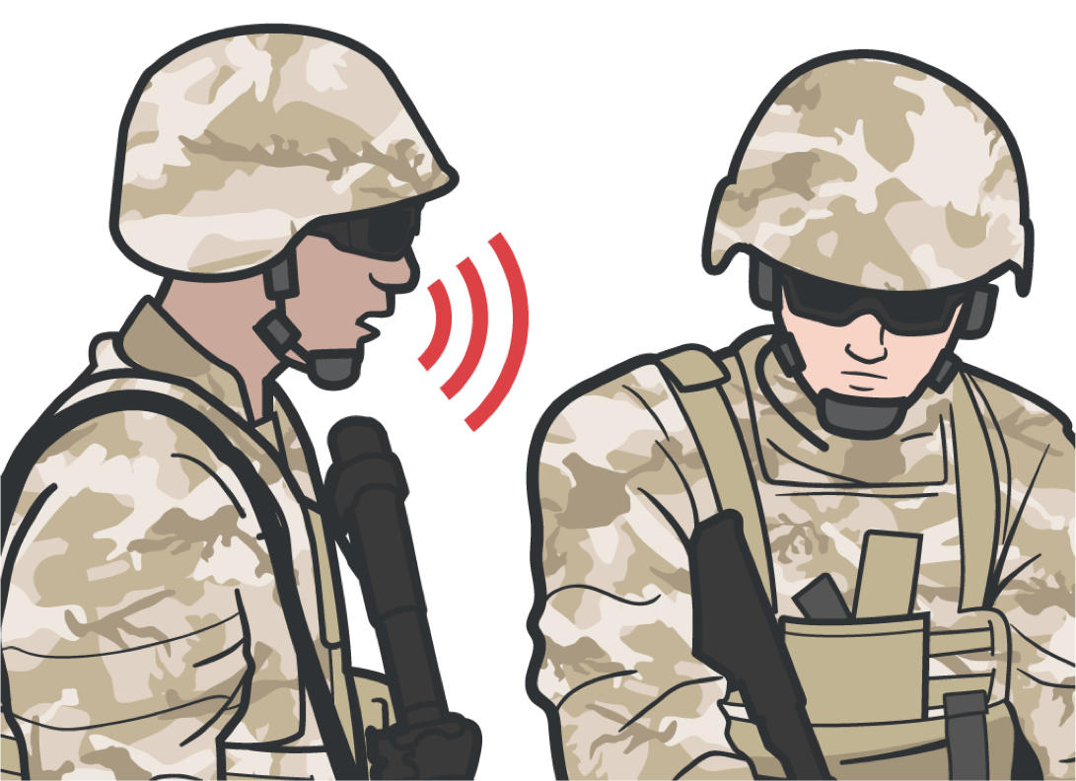
EVACUATION PROCEDURES
WALKING WOUNDED
SELF-CARE
Instruct casualty to repeatedly check their own wounds and dressings to ensure bleeding remains controlled
Provide instructions/ assistance as needed
If possible, casualty may assist as a litter bearer/ provides security
Guide disoriented / visually impaired casualty’s hand-to- shoulder to evacuation platform

Slide 13
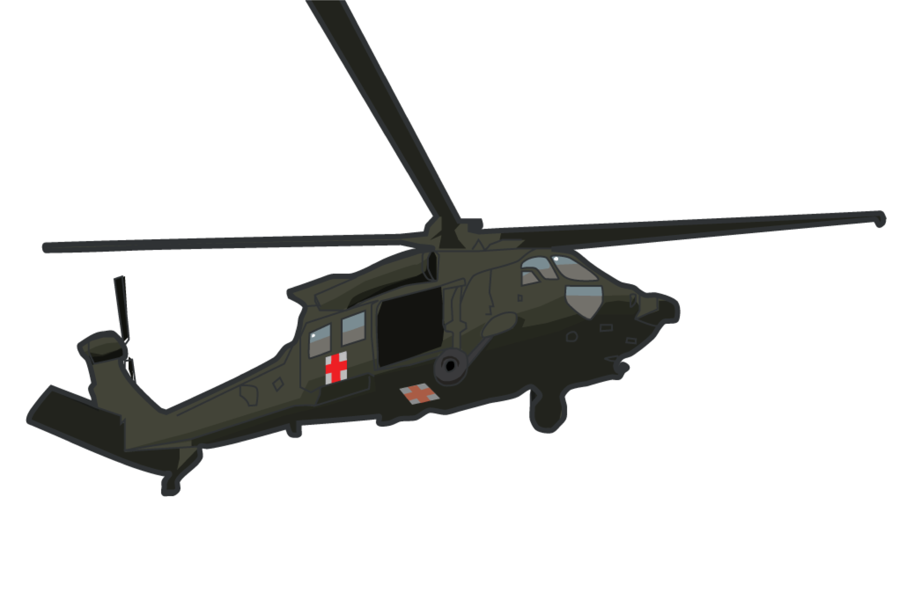
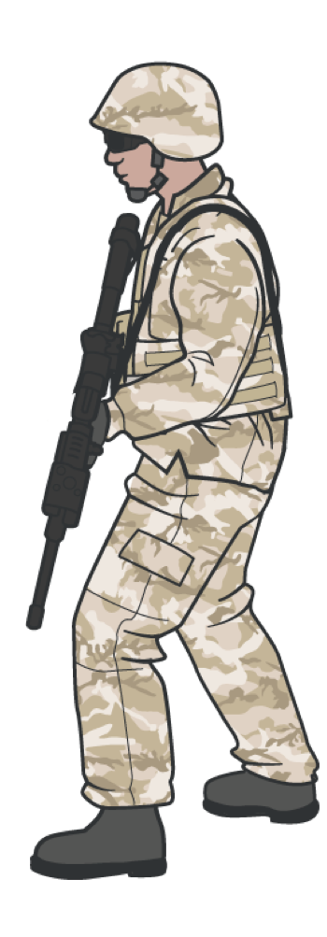

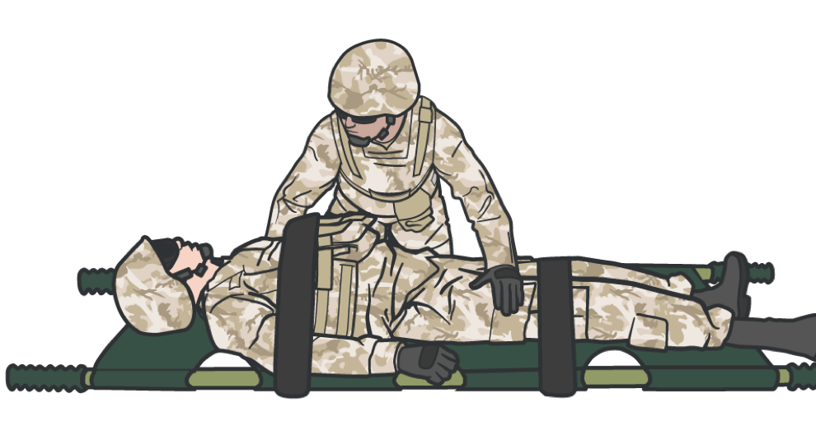
EVACUATION PROCEDURES
STAGE CASUALTY
Be prepared for the arrival of the evacuation platform
Stage the casualties in the loading sequence of the evacuation platform
Many units use tagging
or color-coded chemlights to identify casualty evacuation categories
(Check local SPINS for clarification )
Maintain security at the evacuation point in accordance with SOP

Slide 14

EVACUATION PROCEDURES
MEDICAL AFTER ACTION REVIEW (AAR)
The AAR covers the following
What went right? What went wrong?
What can we do better?
Lessons learned on the casualties and injuries Treatment of casualties and effectiveness during mission
Capturing a good AAR ensures up-to-date medical information, types of casualties, and injury patterns that units might encounter and can train for

Slide 15

SKILL STATION
Evacuation Procedures ‒ Concepts (Skills) Staging for evacuation
Preparing pre-mission evacuation equipment and rehearsing Evacuating casualties with suspected spinal cord injuries Preparing casualties for evacuation
Selecting litter and evacuation equipment in TFC Evacuating ambulatory casualties in TFC Submitting the AAR
Submitting/handing off the *9-Line Report Note: lines 6-9

Slide 16

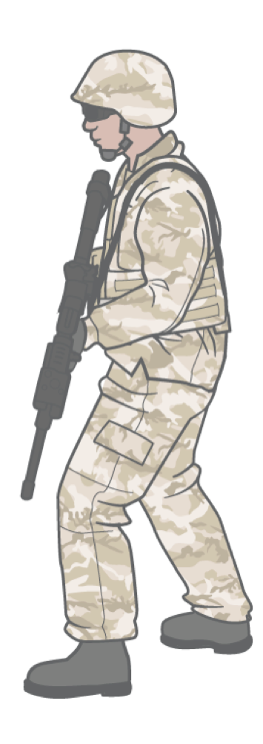
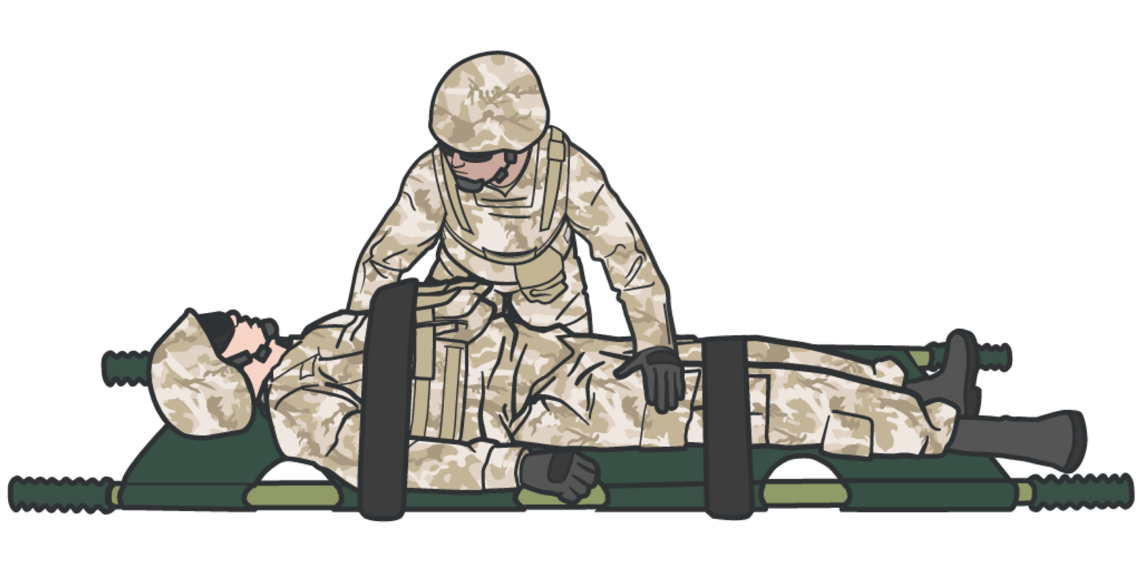
EVACUATION PROCEDURES
SUMMARY
We identified important actions
We discussed securing casualty equipment We discussed evacuation equipment
We identified litter selections
We discussed casualty packaging
We identified spinal injury considerations We discussed walking wounded
We identified staging
We identified considerations for casualty AAR

Slide 17
CHECK ON LEARNING
What actions are needed to prepare for evacuation? What does casualty staging involve?

Slide 18
ANY QUESTIONS?

Slide 19
TACTICAL TRAUMA ASSESSMENT STUDENT PRACTICE

